Slide 1

is
What
OOP Js
?

Slide 2
Constructor
vs
Prototype
is simply a function that is used with new
to create an object.
You can think of a prototype as a recipe for an object.

Slide 3
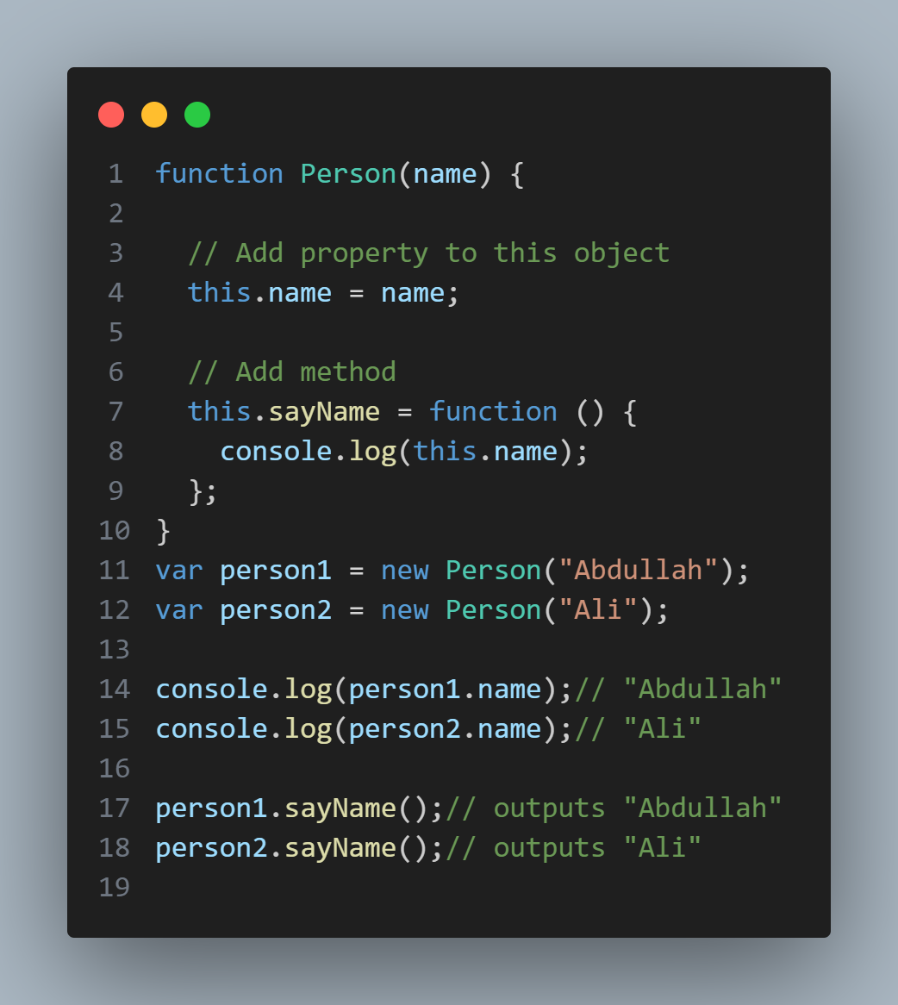
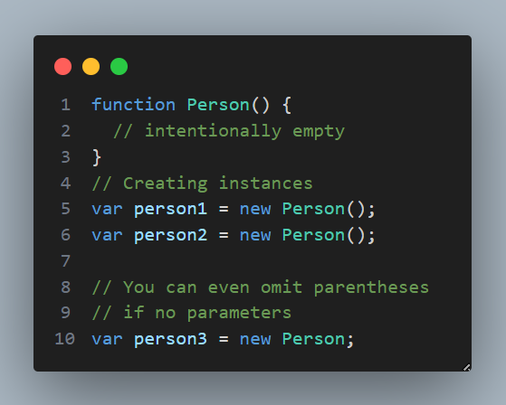
function Person() {
// intentionally empty
}
// Creating instances
var person1 = new Person();
var person2 = new Person();
// You can even omit parentheses
// if no parameters
var person3 = new Person;
Example

Slide 4
How does it work?

Slide 5
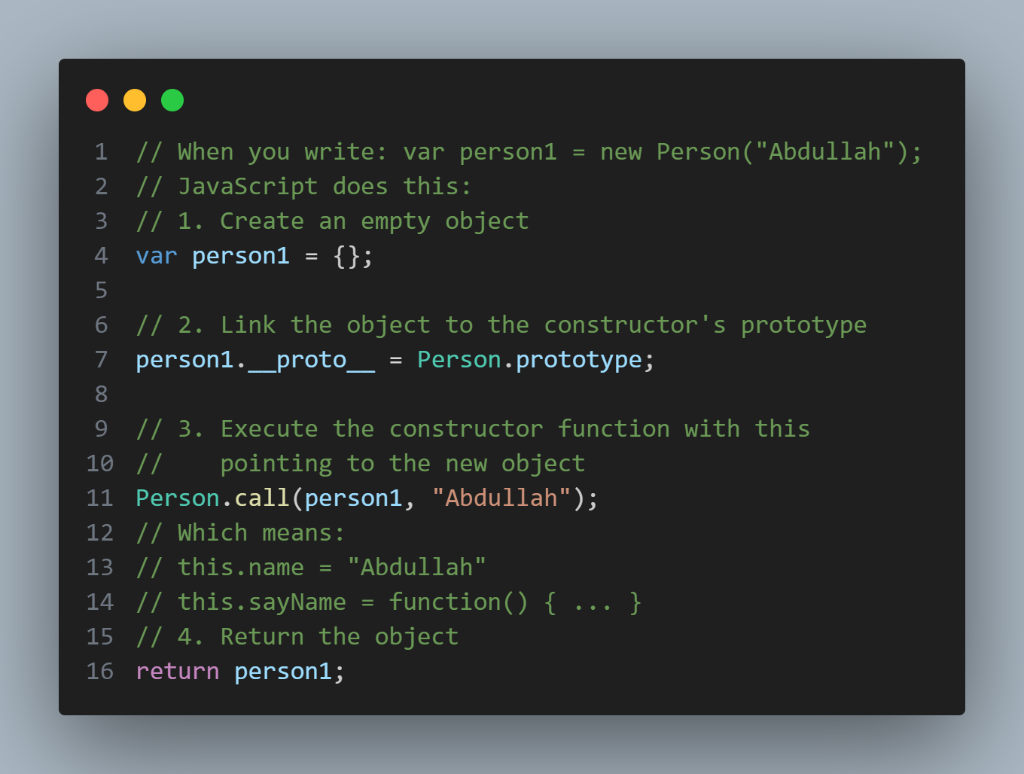
How does it work?

Slide 6
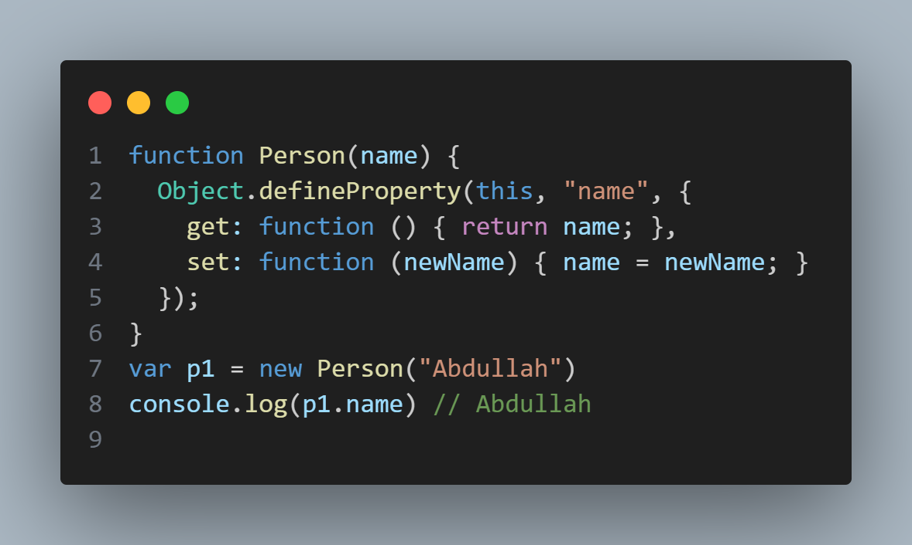
How To Define Property ?

Slide 7
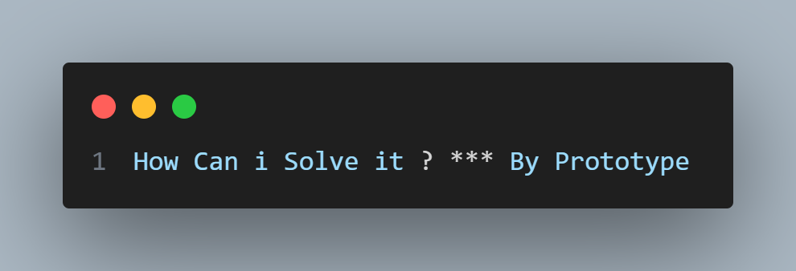
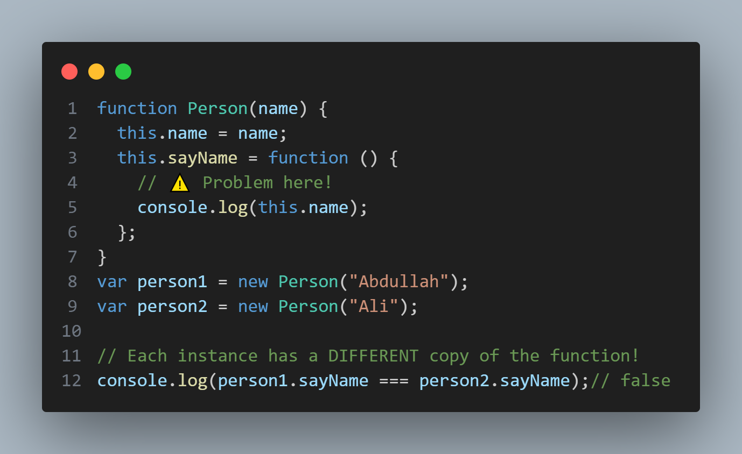
Problem?

Slide 8
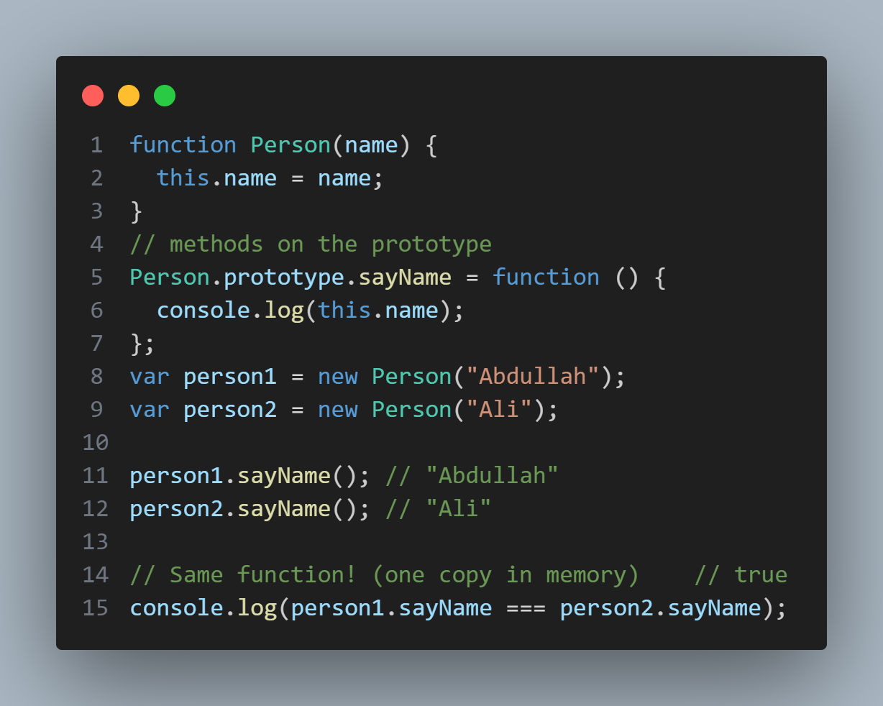
Solution is Prototype:

Slide 9
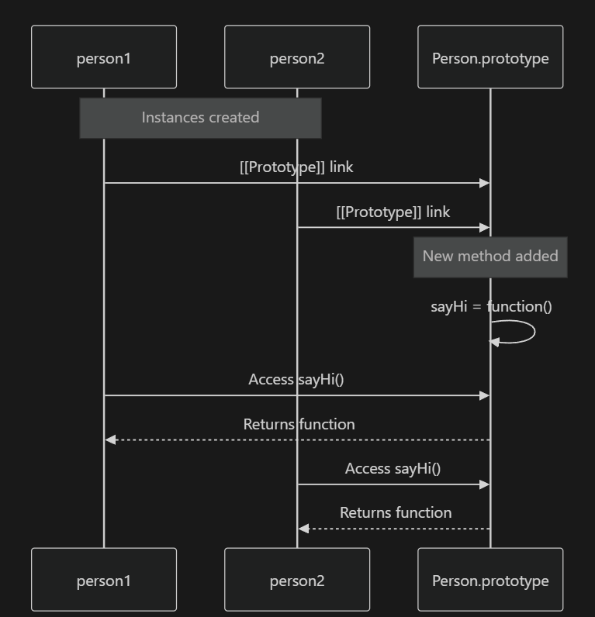
Sequence Diagram for Prototype

Slide 10
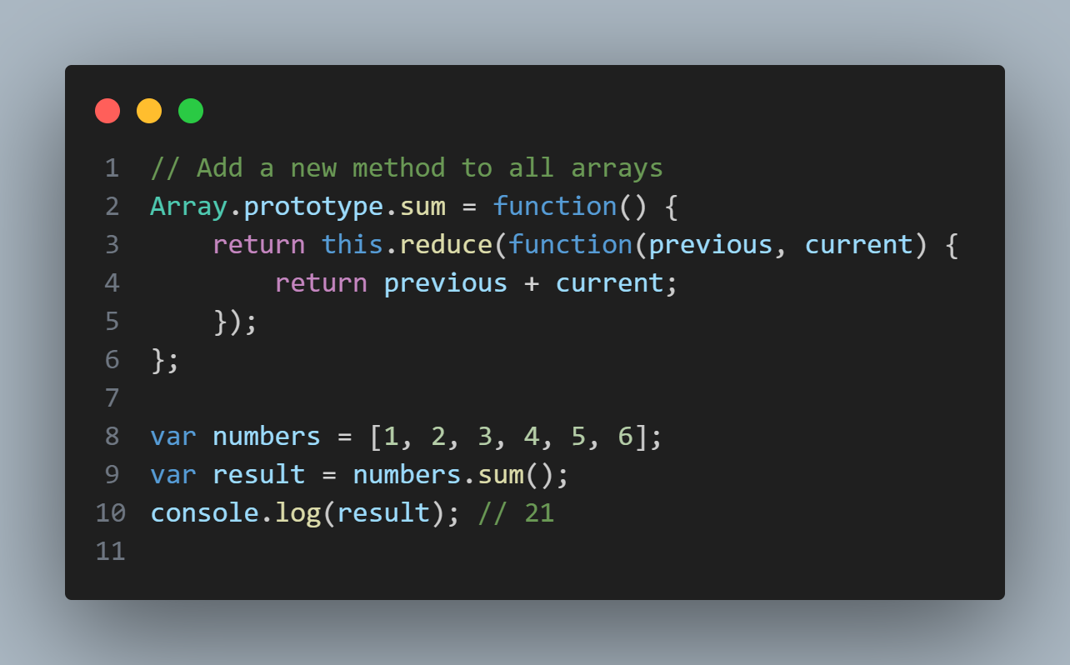
Built-in Object Prototype

Slide 11
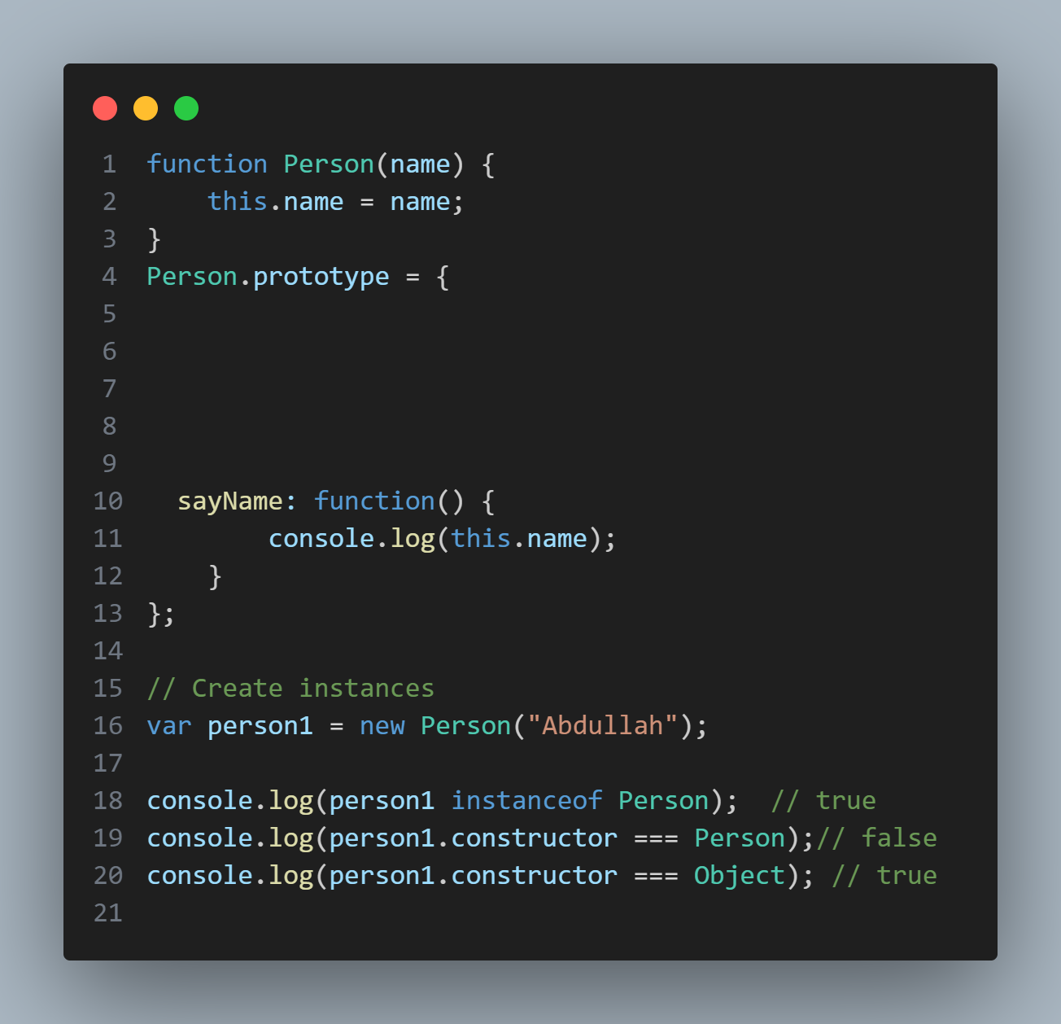
Constructor : Person,
Problem?

Slide 12
Inheritance

Slide 13

Class to Class
Inheritance
Prototype Chaining

Slide 14
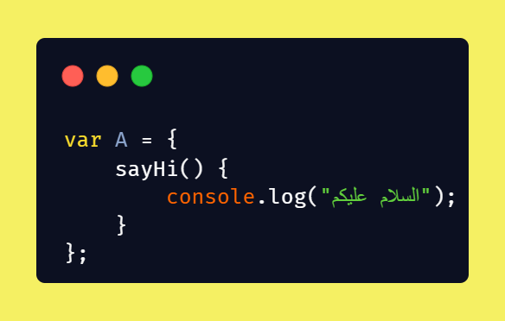
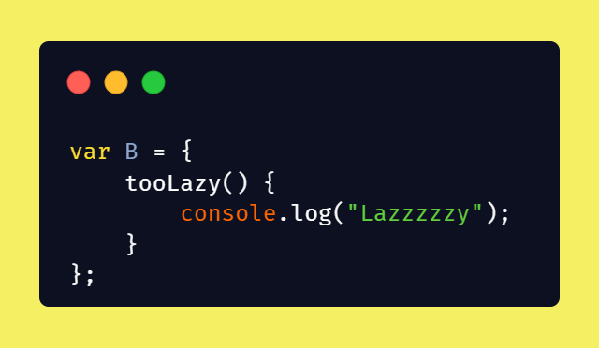
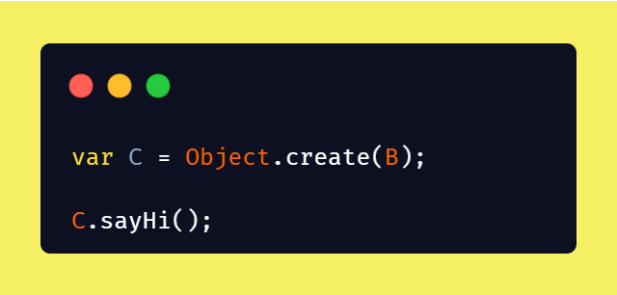
Example

Slide 15
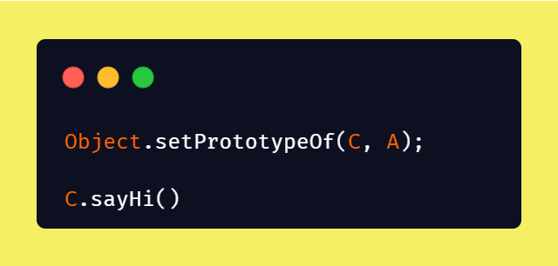
Example

Slide 16
OOP
Concepts
Polymorphism
Encapsulation
Abstraction

Slide 17
Encapsulation
Data hiding + Controlled access
Data should not be accessed directly
Interaction happens through methods
Protects data from invalid changes

Slide 18
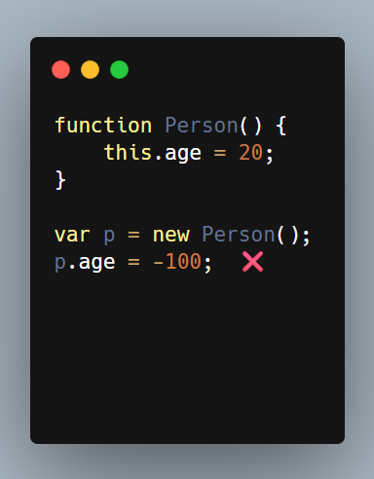
Examples

Slide 19
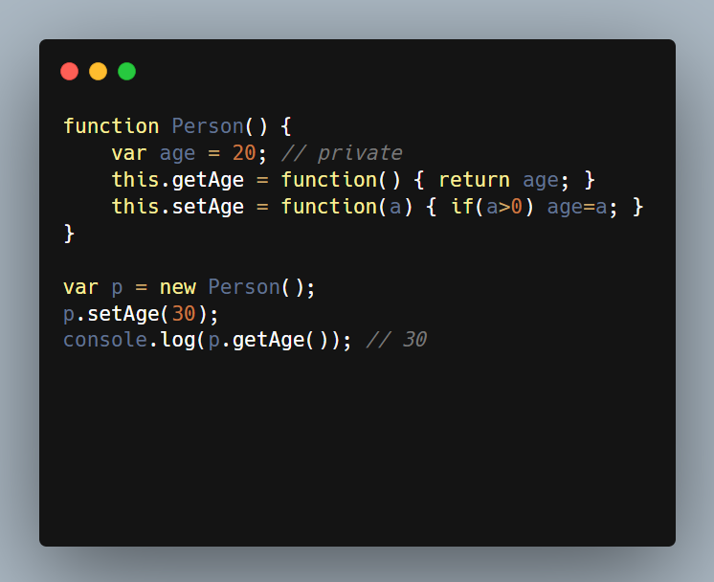
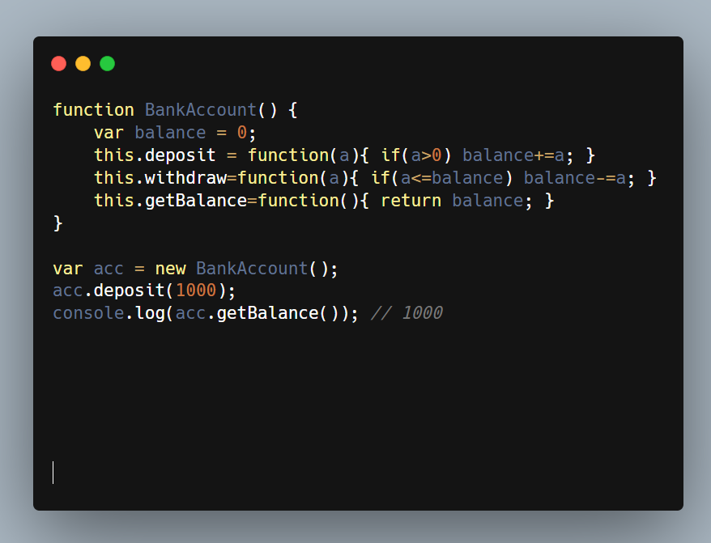
Examples
Closure
Validation

Slide 20
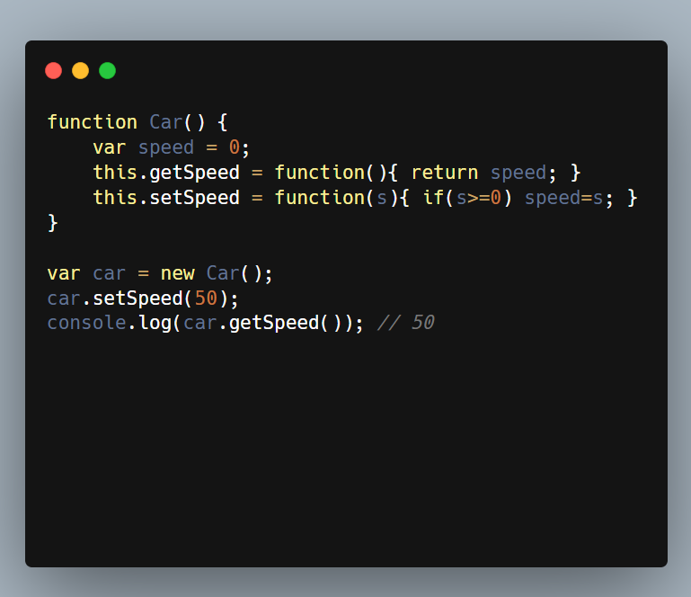
Examples
Prototype

Slide 21
Polymorphism
Same method, different behavior depending on the object.
One method name
Different implementations
Behavior is decided at runtime
“ One interface, many implementations ”

Slide 22
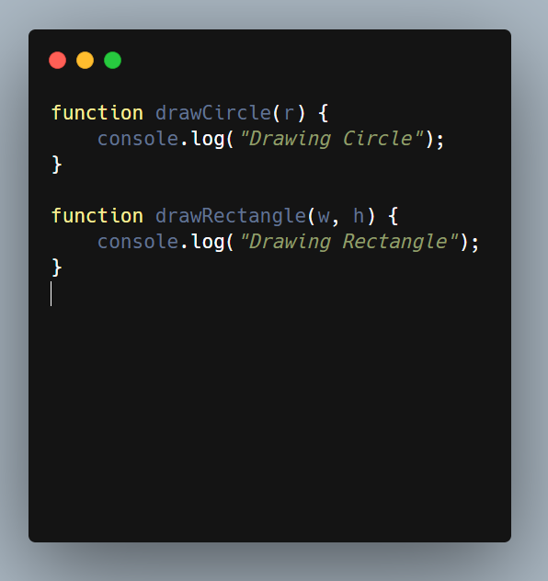
Examples
Problem Without Polymorphism

Slide 23
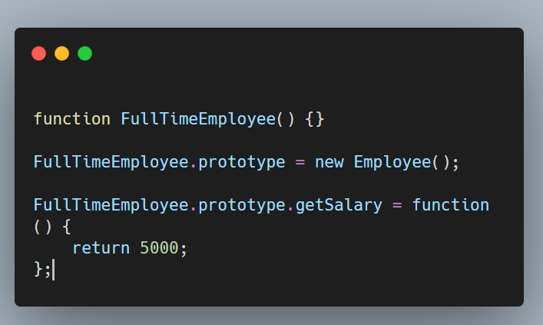
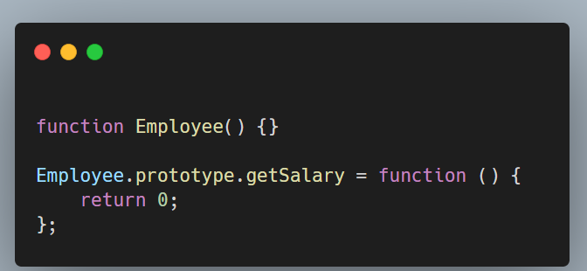
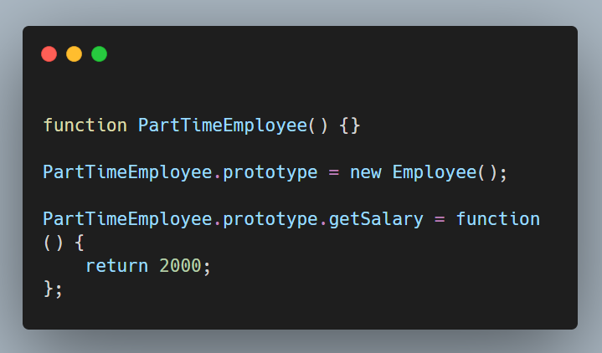
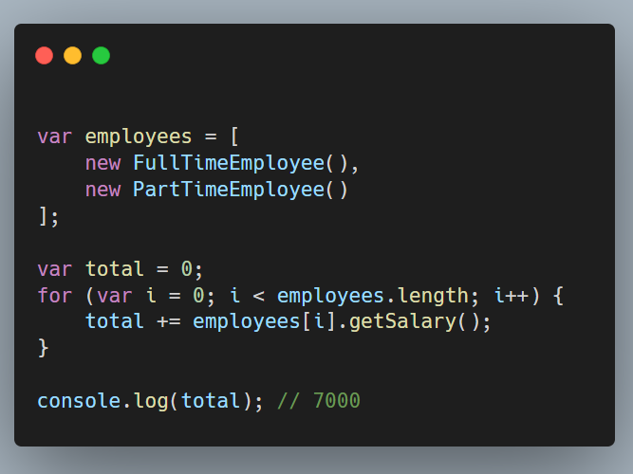
Examples

Slide 24
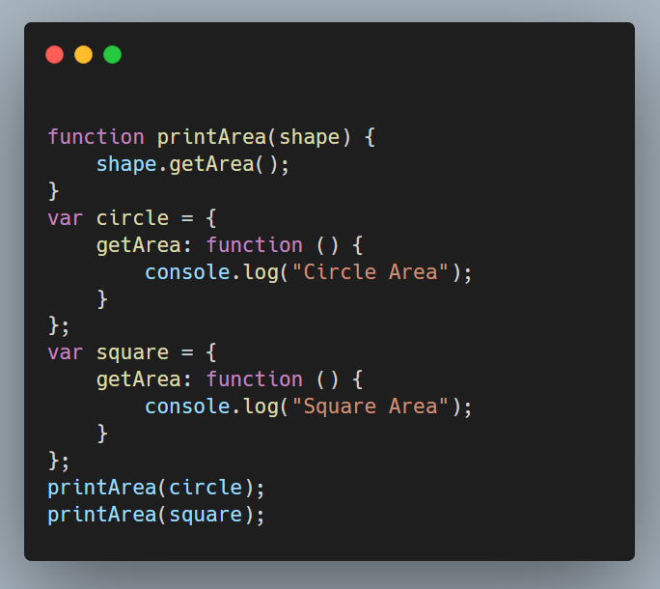
Examples
Polymorphism Without Inheritance (Duck Typing)

Slide 25
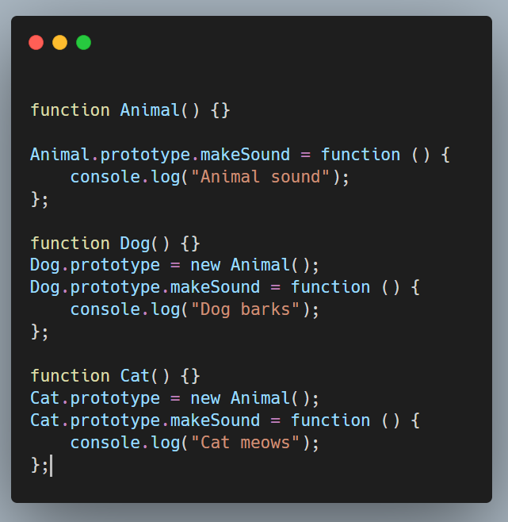
Examples
Polymorphism + Encapsulation

Slide 26
Abstraction
Show what an object does, hide how it works
User focuses on behavior
Implementation details are hidden
Reduces complexity

Slide 27
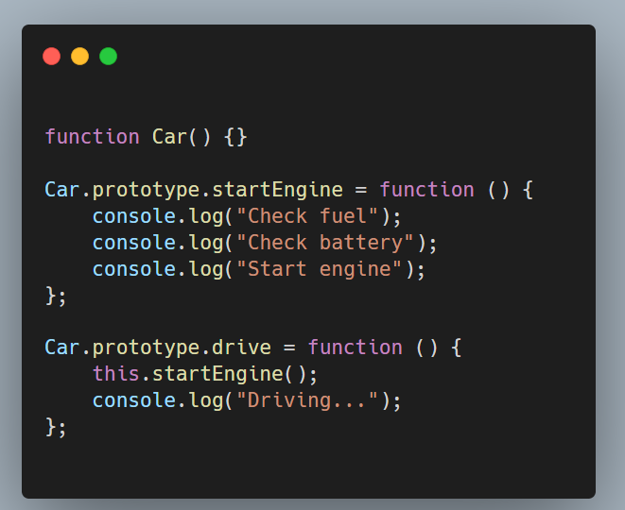
Examples
Problem Without Abstraction

Slide 28
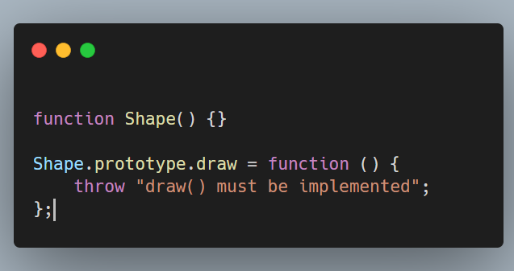
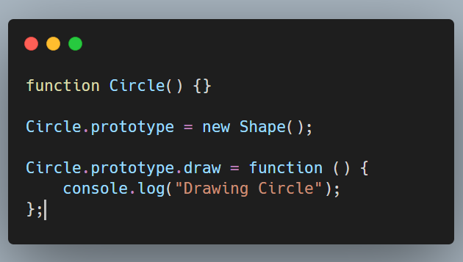
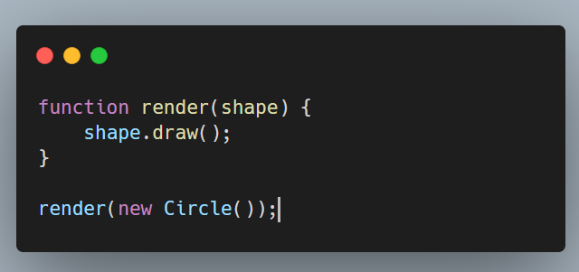
Examples

Slide 29
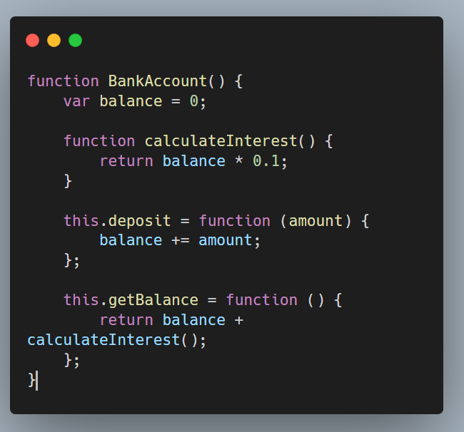
Examples
Abstraction + Encapsulation

Slide 30
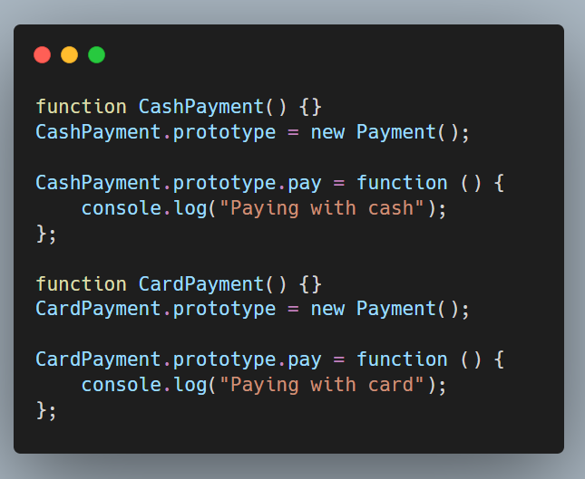
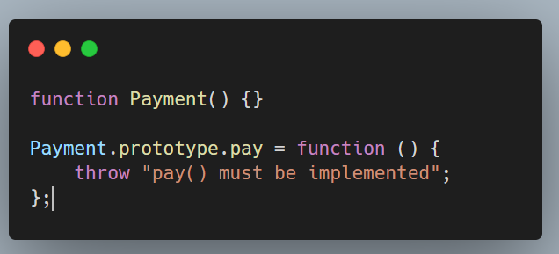
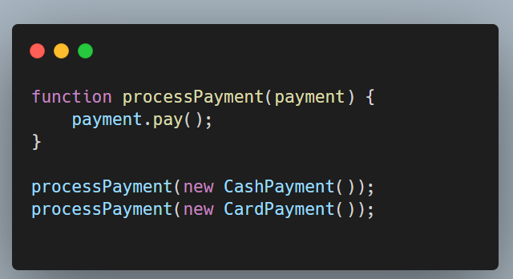
Examples
Abstraction +Polymorphism

Slide 31
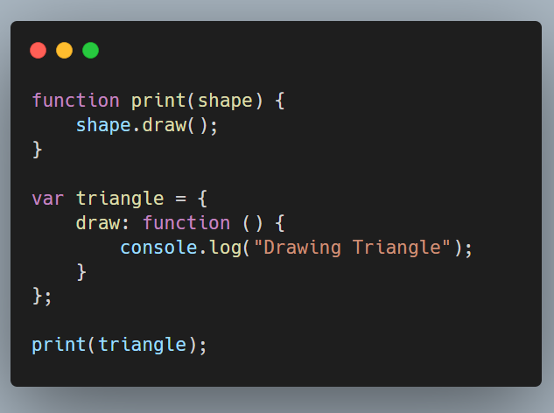
Examples
Abstraction Without Inheritance (Duck Typing)

Slide 32
Static Variable
vs
Static Function
Method attached directly to the constructor , not to instances
Property belongs to the constructor function , not objects created from it

Slide 33
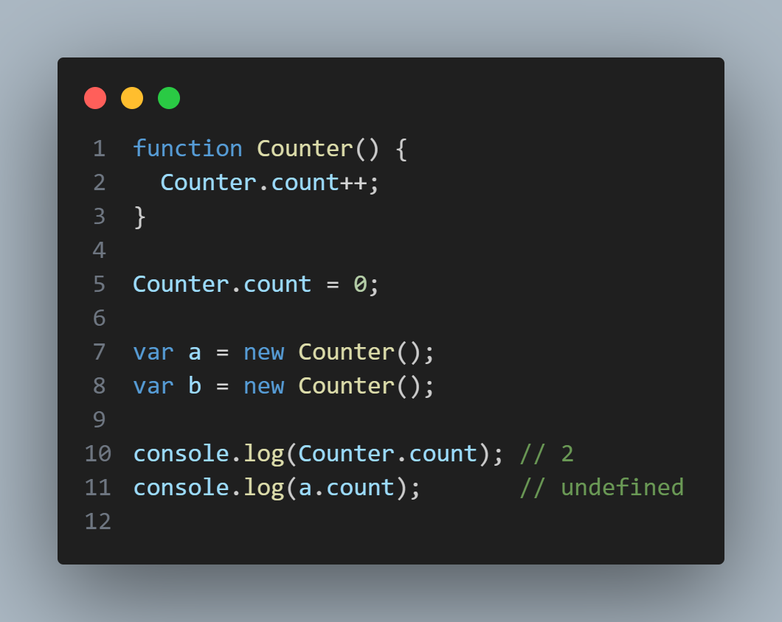
Static Variable

Slide 34
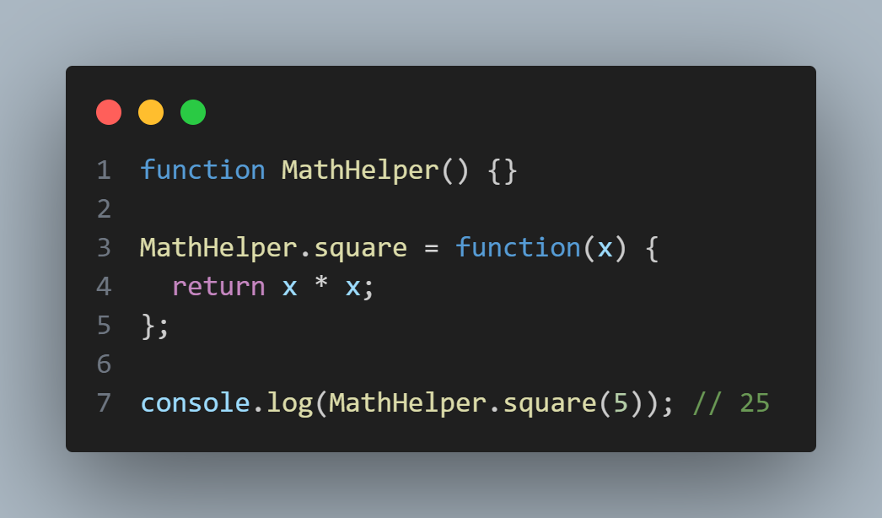
Static Function

Slide 35
for
Thanks
listening
!

